Slide 1
PRE-HEALTH RESEARCH JOURNAL CLUB

Slide 2
Agenda
01
02
03
04
About us.
Brief introduction of the members
Introduction into Research.
How this club can combine you and research
What this club can do for you.
Here you could describe the topic of the section
Mock Presentation
Here you could describe the topic of the section

Slide 3
Our Mission:
Summer Session Journal Club
The Pre-Health Research Journal Club is an interdisciplinary student-run club at Hunter College. We will hold meetings twice a month at the start of the summer session, starting June 1st.
Provide a platform for a group of individuals that are interested in discussing research that has been published in scientific journals. Students will be encouraged to ask questions and contribute to scientific discussions during these meetings.
Improve critical literature interpretation skills and discuss controversies amongst the field of research and medicine. Students will better understand how results of studies can be used in clinical practice.
Students who are official members of the club will be eligible to partake in their own presentations. The founders will serve as mentors and help generate ideas for presentations on publications students are interested in. Mentorship will be available to students who are also interested in pursuing research opportunities they would be interested in being a part of.
Substitute the loss of opportunities (i.e. internships, shadowing appointments, chances to pursue research) during Summer 2020. This club is a great chance for students to still build their resumes and build their critical thinking skills that can be applied in scientific investigation.
Students will also be able to use the journal club sessions as event credit towards their Pre-Health file.

Slide 4
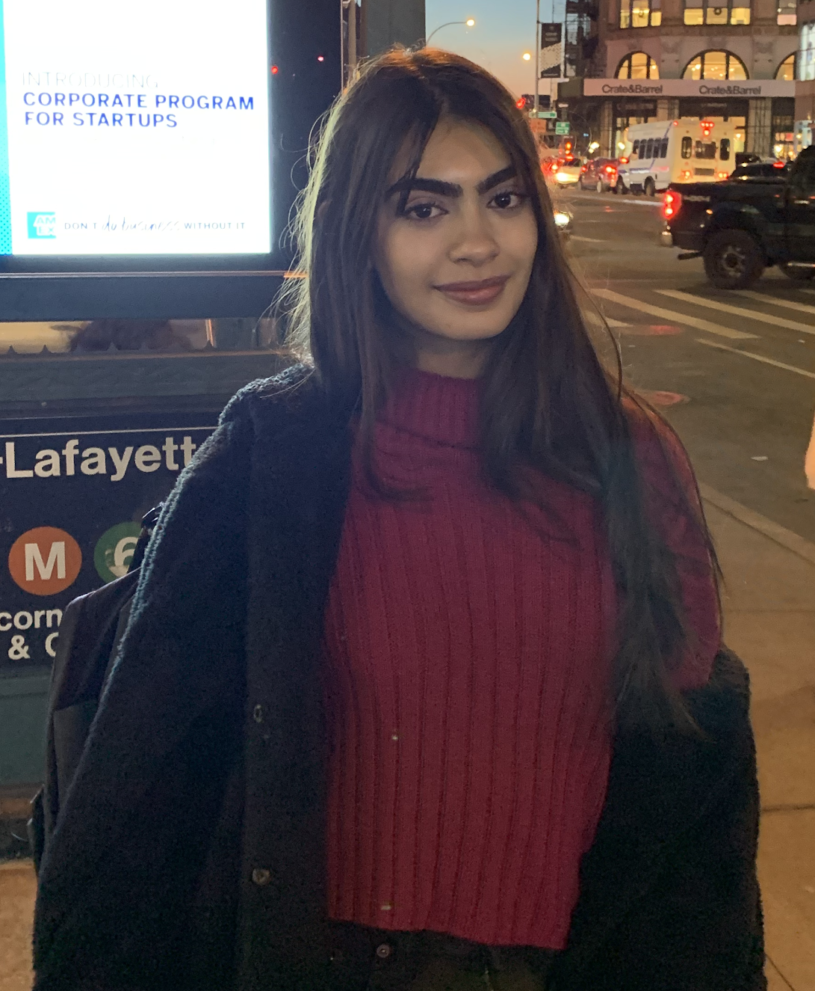
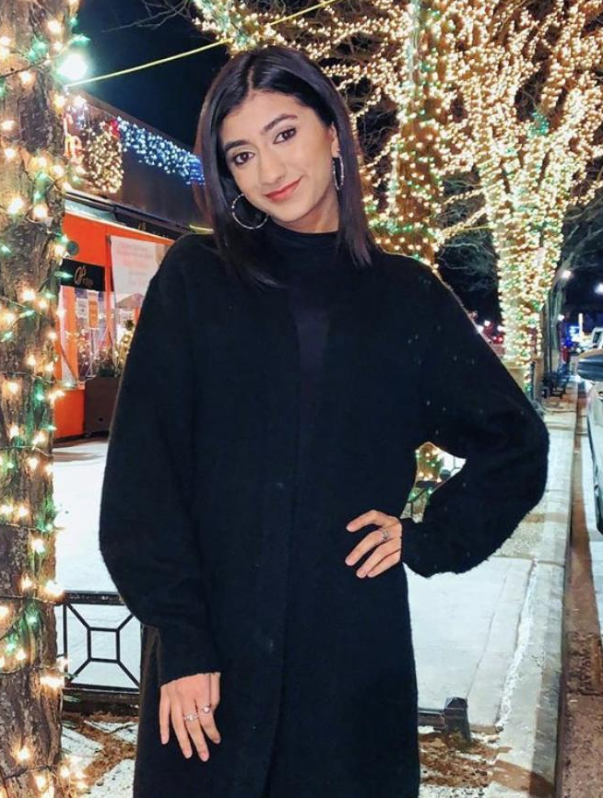
01 ABOUT US
Hi, I’m Mahnoor Memon. I’m a sophomore majoring in biochemistry with a sociology minor from the Thomas Hunter Honors Program. In my free time I like to listen to music and paint. We wanted to start this club to help fellow students gain research exposure and to have a place for students to collaborate during this time.
Hi! I’m Zaina Syed and I am a sophomore majoring in biochemistry in the Roosevelt Scholar Honors Program. This club will be a great way for us to stay active and it’ll help sharpen our research literature skills. I hope you all will decide to join us!

Slide 5
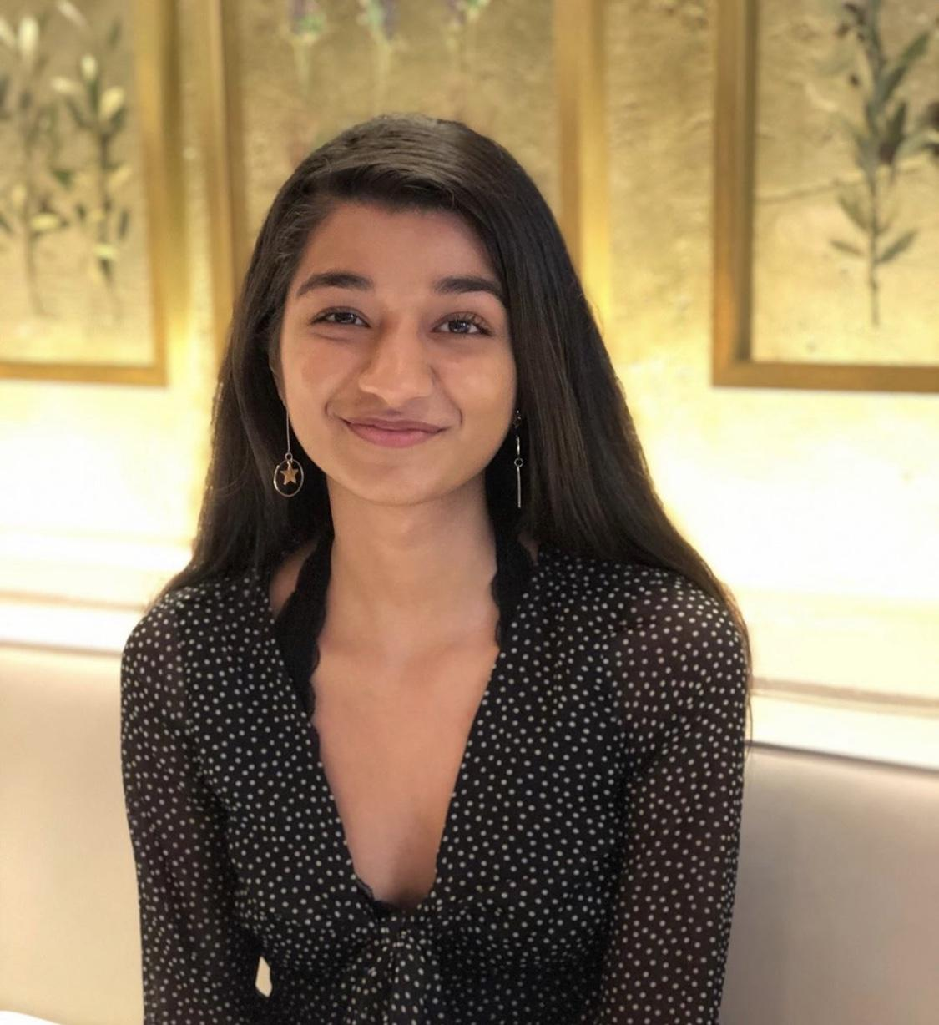
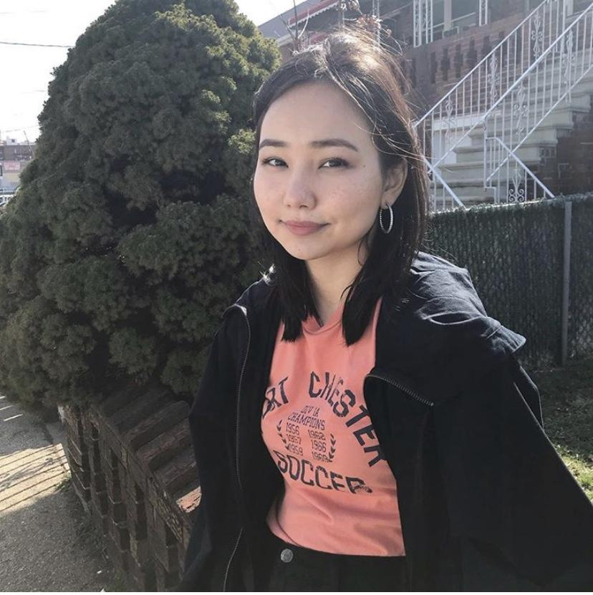
ABOUT US
Alia Isabekova
Deepshikha Kewlani
Hi all! I am a pre-PA sophomore majoring in Sociology. I’m also a Sage Honors scholar. Like many of you, I lost my internship for the summer. The Pre-Health Journal Club is a way for all of us to have some fun and learn useful research skills while stuck at home.
Hey everyone! I’m currently a sophomore majoring in Biology and minoring in Cultural Anthropology through the Thomas Hunter Honors Program. I’m genuinely looking forward to be working with students to present research that we can all learn from!

Slide 6

ABOUT US
Natalya Krutovska
Hi all! I am currently a sophomore in the Jenny Hunter Honors program and on the pre-medicine track, I’m pursuing a double major in Neuroscience and Chinese Language along with a minor in Public Health. From my experience in a research lab, I’ve found Journal Club discussions to be very informative and it gives the opportunity to grow knowledge in different fields beyond the research one is doing. We created this interactive platform for students to be able to grow their scientific literature appraisal skills and to be able to present on research they’re interested in as well. We hope to make this club about you! Our mission is to cultivate everyone’s intellectual curiosity in research in a way that can help grow your future endeavours!

Slide 7
02
Introduction into research
What is research and the role of this club.

Slide 8
What is research and what you are expected to know
Research allows us to test theories and establish new conclusions in a number of fields
For Pre-Health students research allows us to understand the science behind mechanisms.
With the given situation of the world right now, research is something that connects us with the unknown.
Through research we are able to come up with vaccines and treatments that are crucial for times like these.
Pre-Health students are expected to know how to read scientific articles and dissect them in research labs. This is where our club comes in.

Slide 9
What’s a journal club?
A regular gathering of typically scientists/healthcare workers, but in our case science interested students to discuss a recent paper found in a research journal
A group of students present a summary and analysis of the chosen paper that the rest of the club has read
Then the focus is on the discussion, where we could ask clarifying questions and add our own critiques or praises on the methods and research design
A journal club could help expand what we know about the scientific world of research with new experimental plans and future directions
It also facilitates an exchange of thoughts and ideas

Slide 10
03
What this club can do for you
How this club can connect you and research.
Club expectations and what it takes to present.

Slide 11
How can this club connect you and research?
Reading research literature can be challenging. We hope to improve everyone’s literature skills as it will allow us to deeply understand the texts.
Students will learn how to ask scientific questions.
This club will allow students to generate ideas for research they may want to pursue in the future.
Students will develop skills for presenting scientific information.
We will discuss controversies occurring in research.
By reading scientific journals, students will learn more about scientific discoveries.
This club also gives you research experience that you could use to make your application to research labs stand out.

Slide 12
Club Expectations/What it takes to present
We expect students to attend sessions four times a month through Webex
To present you must attend two sessions or have previous research experience.
You are free to choose a research topic of your interest and this can be done in groups of five or less.
Those who wish to present must submit a Google Form and provide a pitch that would determine eligibility and dedication on your topic and information.
You should fill out the form at least two weeks before you plan on presenting.

Slide 13
Questions?

Slide 14
Mock Presentation
04
The Role of Infections and Autoimmune Diseases for Schizophrenia and Depression: Findings from Large-Scale Epidemiological Studies

Slide 15
General Outline of Presentations
10 minutes on background
5-10 minutes about the article
15-20 minute analysis
5 minute discussion

Slide 16

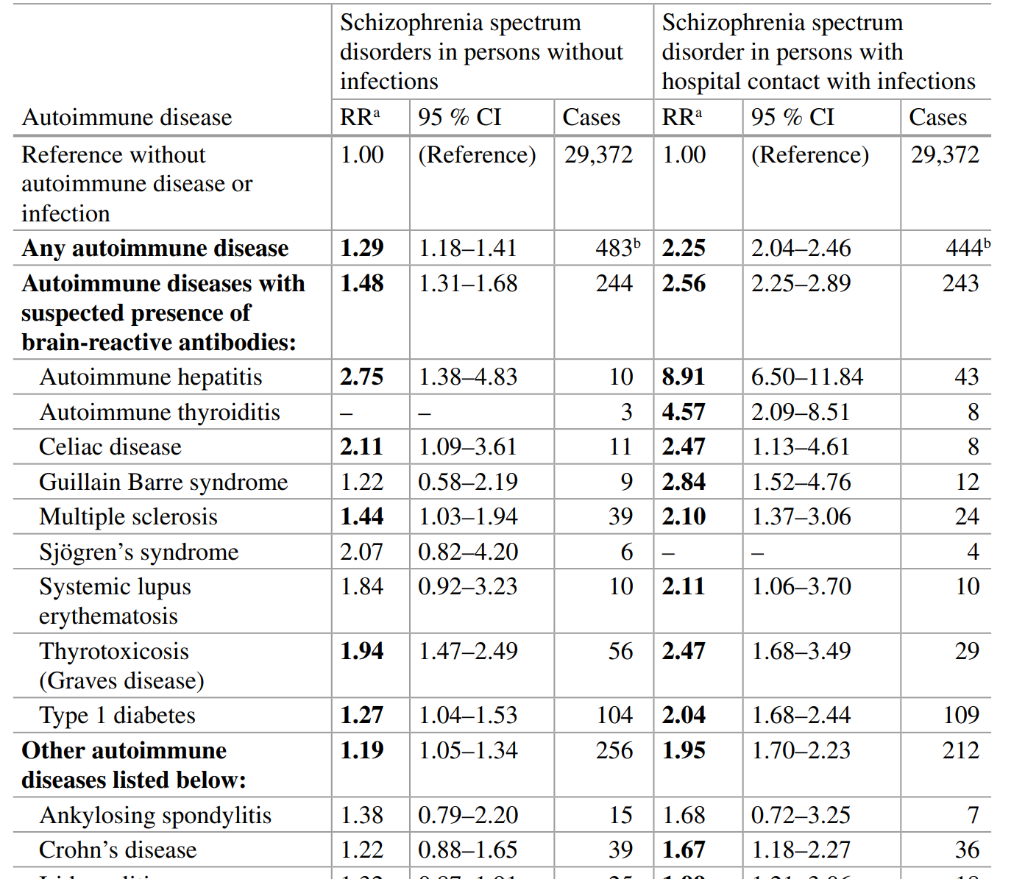

Slide 17
